Slide 1
Production and Costs
Module 3
Management 405 · EMBA
Prof. Nico Voigtlaender · UCLA Anderson
Notes:
Welcome – this is Module 3, Production and Costs. Last time we wrapped up the demand side; tonight we tackle the supply side and how output depends on inputs. By the end you'll have all the pieces you need for Module 4, where we put demand and costs together to find profit-maximizing decisions.

Slide 2

Module 3 · Logistics
Zoom-Specific Logistics
If your internet permits, keep video on, mic muted
Class discussions: raise hand
Will call on you to unmute
Chat on Zoom: only clarifying questions to TA
TA will filter questions and raise hand if needed
Group discussions / exercises: breakout rooms
Management 405 · Module 3 · Production and Costs
2
Notes:
Quick housekeeping before we dive in: Zoom rules. Video on if your bandwidth allows, mic muted by default. Raise hand to be called on; use the TA chat for clarifying questions. Group exercises run in breakout rooms – I'll move between them. Then we move on.

Slide 3
Module 3 · Announcements
Announcements
Midterm logistics
3.5-hour window at home, any time during {{MIDTERM_WINDOW}}
Guaranteed TA availability: {{TA_WINDOW}}
Material covered
All material from Modules 1 and 2 (includes PS 1 + 2)
Problem-solving exercises similar to PS 1 + 2
Review sessions during the midterm week
Management 405 · Module 3 · Production and Costs
3
Notes:
Before we dive into Module 3 – two quick announcements about the midterm. It's a 6-hour at-home window over the dates shown; pick any contiguous block within that window. We'll have a TA on call for one guaranteed support window – use it if you'd like to ask live questions. Material covers Modules 1 and 2, including both problem sets. Review sessions will run during the week of the midterm; details by email.

Slide 4
Module 3 · Recap
Recap of Module 2
The law of demand
Holding everything else constant, if P falls, Q rises
Elasticities
Responsiveness of demand to own-price, income, competitors' price
Demand and revenue
Own-price elasticity drives total revenue; marginal revenue via the 3-step method
Demand estimation
Market experimentation and regression analysis
Management 405 · Module 3 · Production and Costs
4
Notes:
A 60-second reminder of where Module 2 left us: demand curves, price elasticity, and marginal revenue. The revenue side is settled; tonight we crack open the cost side. Once both sides are in hand, profit-maximization in Module 4 falls out almost mechanically.

Slide 5
Module 3 · Course Roadmap
Agenda for the Class
1. Basic Principles and Economic Way of Thinking
2. Value and Demand
3. Supply and Cost
we are here
4. Markets, Pricing, and Strategy
Management 405 · Module 3 · Production and Costs
5
Notes:
This is where Module 3 fits in the 405 course as a whole. We started with the Basic Principles and the Economic Way of Thinking. Module 2 covered Value and Demand – the customer side. Tonight is Module 3, Supply and Cost – the firm side. Module 4 ties it all together in Markets, Pricing, and Strategy. So tonight you're filling in the right-hand box on this map.

Slide 6
Module 3 · Production · Big Picture
Big Picture of Module 3
Production Functions
Demand
Costs
Output Decisions
Management 405 · Module 3 · Production and Costs
6
Notes:
The big-picture frame for the night. Every executive decision you've ever made – pricing, hiring, capacity, sourcing, outsourcing – is at some level a production-and-cost decision. Tonight builds the left-hand chain in this diagram: Production Functions describe how inputs become output, and Costs translate those inputs into dollars. Combined with Demand from Module 2, they give us Output Decisions in Module 4 – pricing and profit-maximization. Click through the boxes one at a time to walk the students through the flow.

Slide 7
Module 3 · Concept Map
How the Pieces of Module 3 Connect
PRODUCTION
COSTS
Production function
Cost types
$$Q = f(K, L)$$
$$TFC / TVC / AFC / AVC / ATC / MC$$
Short Run (K fixed, L flexible)
Long Run (Both K and L flexible)
Fixed costs ⇒ ignore if they are sunk
Marginal Costs crucial for optimal output decisions: MR = MC (In Module 4)
Average Costs mostly for accounting purposes
Hire until
Bang-for-the-buck
$$MRPL = w$$
$$\frac{{MP}_{K}}{p_{K}} = \frac{{MP}_{L}}{w}$$
↑ short-run optimization
↑ long-run optimization
Minimum cost for any given Q
Optimized production leads to minimum-possible costs
If long-run AC falls with Q ⇒ Economies of Scale
MB = MC
(of labor)
MB = MC
(of output)
Management 405 · Module 3 · Production and Costs
7
Notes:
Two parallel trees – Production and Costs. On the Production side, the production function Q = f(K, L, M) branches into two time horizons (short run, long run), each with its decision rule rendered in proper math notation: MRPL = w for short-run hiring and MP_K/p_K = MP_L/w (bang-for-the-buck) for long-run input mix. The italic gold labels under each rule remind students that these rules ARE the optimization conditions in their time horizons. The gold callout flags the cleanest MB = MC instance (hiring); bang-for-the-buck is the related marginal-benefit-per-dollar rule, so the callout doesn't extend there. The gold-outlined bridge band at the bottom names the link to Costs: solving the optimization conditions minimizes cost for any given output, and the cost concepts on the right describe what those minimized costs look like. Use this slide as the roadmap to return to at section transitions.

Slide 8
Module 3 · Agenda
Part 1: Production – Picking the Right Inputs
Part 1: Production – Picking the Right Inputs
Production Function
Short Run – Hiring Decisions
Long Run – Optimal Input Mix
Part 2: Costs – Producing at the Lowest Price
Cost Concepts
Scale & Scope
Management 405 · Module 3 · Production and Costs
8
Notes:
Entering Part 1 – Production. The core question for the next 40 minutes: how does output depend on inputs? We'll do short-run hiring decisions first, then long-run input choice.

Slide 9
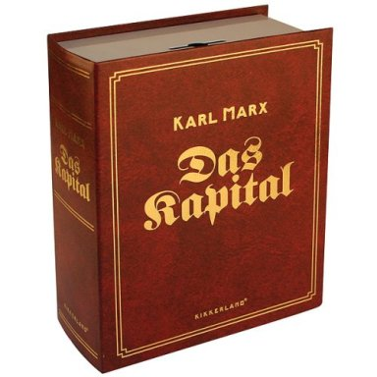
Module 3 · Production · Short Run
The Production Function
Q = f (K, L, etc)
Q = Output
f = a function of inputs:
K = Capital (physical: factories, machinery, software, IP)
L = Labor
"etc" can be raw materials, energy...
Marx, Das Kapital (1867)
A production function transforms inputs into outputs.
The more efficient this process, the higher is productivity
Management 405 · Module 3 · Production and Costs
9
Notes:
The production function in its most basic form: output Q is a function of capital K, labor L, and any other inputs the firm uses – raw materials, energy, and so on. Capital is more than buildings – it includes machinery, software, IP, AI systems – anything you've already paid for that keeps producing. The callout at the bottom captures the big idea: a production function maps inputs into outputs, and the more efficiently it does so, the higher is productivity. Everything else in the module is built on this expression.

Slide 10
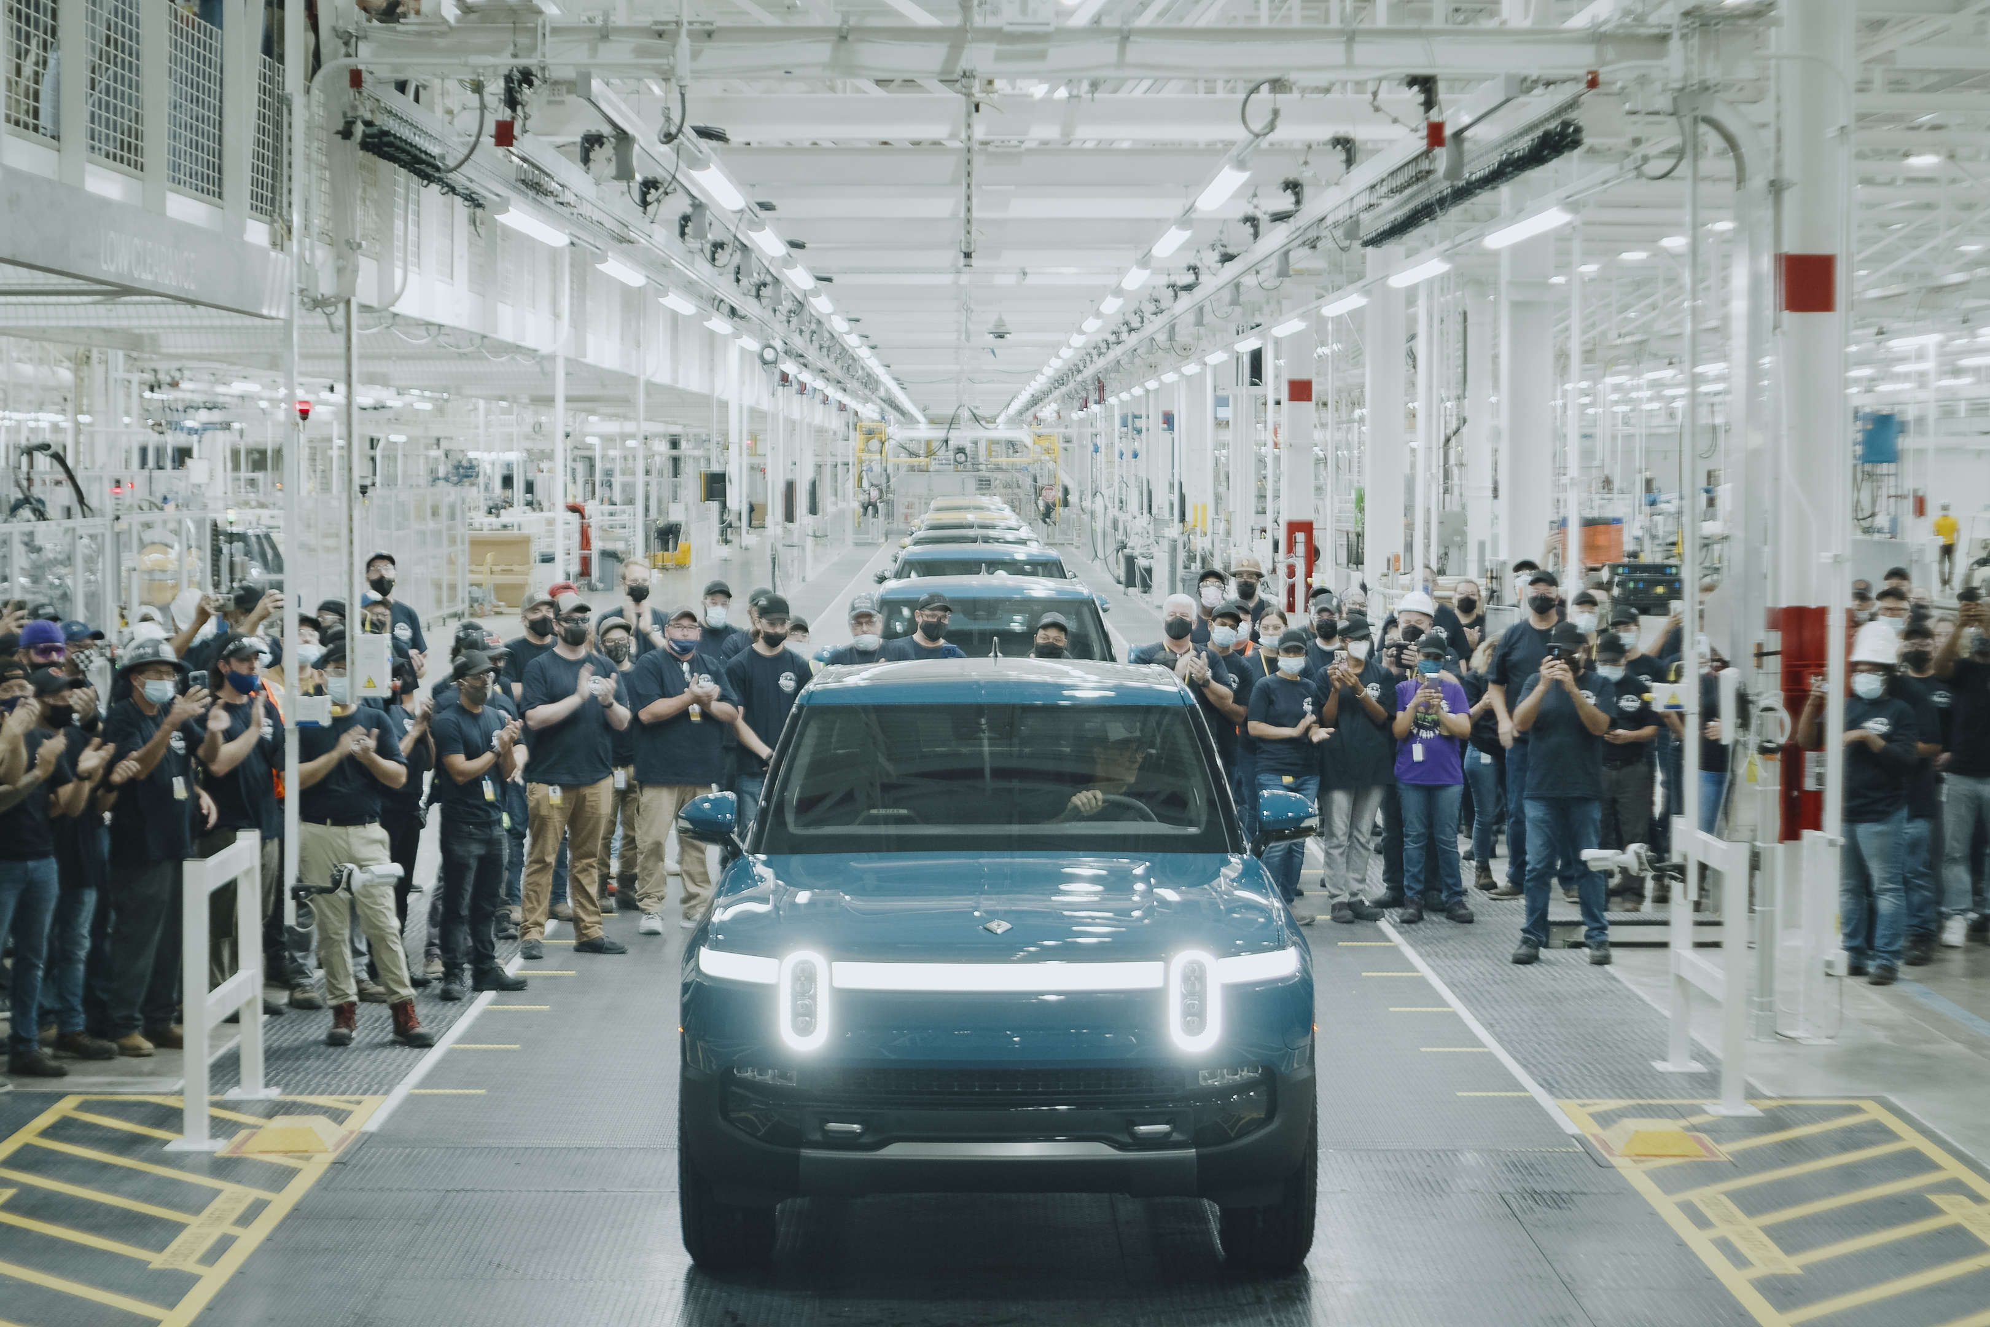

Module 3 · Production · Short Run
Short vs. Long Run: A Critical Distinction
In the short run, some inputs (fixed factors) cannot be increased or decreased
The long run is a period long enough for all inputs to be variable
Capital fixed in short run
Labor (ophthalmologists) fixed in short run
Rivian Normal, IL plant (CC BY-SA, Wikimedia)
Management 405 · Module 3 · Production and Costs
10
Notes:
The single most important time-scale distinction in this course. Short run = some inputs are fixed factors — you cannot vary them within the planning horizon. Long run = a horizon long enough that EVERY input becomes variable. The two photos give parallel examples of short-run fixed factors. Left: Rivian's Normal, Illinois assembly plant — capital (the building, the robot fleet) is fixed in any given quarter; they can ramp shifts and headcount but not the four walls. Right: an ophthalmologist — skilled labor with many years of training is also a fixed factor in the short run; a hospital cannot conjure up another ophthalmologist on a month's notice. Both illustrate the same lesson: in the short run, you optimise around the factors you cannot change.

Slide 11
Module 3 · Production · Short Run
Rivian's Production Function: R1 Line Weekly Output
Number of robots (K)
 | 100 | 200 | 300 | 400
0 | 0 | 0 | 0 | 0
250 | 165 | 234 | 286 | 331
500 | 204 | 288 | 353 | 407
1,000 | 251 | 354 | 434 | 501
1,500 | 283 | 400 | 490 | 566
2,000 | 309 | 436 | 534 | 617
2,500 | 330 | 467 | 571 | 660
3,000 | 348 | 493 | 604 | 697
3,500 | 365 | 516 | 632 | 730
4,000 | 380 | 537 | 658 | 760
4,500 | 394 | 557 | 682 | 787
5,000 | 406 | 574 | 703 | 812
Number of
cars
Number of workers (L)
Output = cars per week
MPL falls down each column; MPK falls along each row
Management 405 · Module 3 · Production and Costs
11
Notes:
Rivian's R1 line weekly output as a function of workers (L) and robots (K). Built from the Cobb-Douglas Q = 3.155 · √K · L^0.3 – strictly diminishing in each input individually. Look down a column: MPL falls as you add labor with capital fixed. Look along a row: MPK falls as you add robots with labor fixed. Strict diminishing returns in both directions – the textbook story. Per-worker MPL is also strictly diminishing across the non-uniform L grid (extra L=250 step at the start).

Slide 12
Module 3 · Production · Short Run
Plotting Total Output: Q vs. L on the R1 Line
Each curve flattens as L rises (diminishing MPL)
The vertical distance between curves narrows as K rises (diminishing MPK)
Management 405 · Module 3 · Production and Costs
12
Notes:
Same numbers as the table on the previous slide, now plotted. Four lines for four plant-capital levels (100, 200, 300, 400 robots). Each line rises but flattens – diminishing MPL. The vertical spacing between adjacent lines narrows as K grows – diminishing MPK. Memorise this shape: it shows up in every production context, from factories to consulting teams.

Slide 13
Module 3 · Agenda
Part 1.b: Short Run – Hiring Decisions
Part 1: Production – Picking the Right Inputs
Production Function
Short Run – Hiring Decisions
Long Run – Optimal Input Mix
Part 2: Costs – Producing at the Lowest Price
Cost Concepts
Scale & Scope
Management 405 · Module 3 · Production and Costs
13
Notes:
Quick orientation. We've established what a production function is and how it behaves. Now we shift into the short run – capital is fixed, labor is the lever – and ask the operating question: how many workers should the firm hire? The next several slides build the marginal-product machinery we'll use to answer that.

Slide 14
Module 3 · Production · Short Run
Short Run: Marginal Product of Labor
▪ Typically in the short run:
– Capital is fixed ($\overline{K}$)
– Labor is flexible ($L$)
▪ Important Concept: Marginal Product of Labor
– The marginal product of labor is the change in output due to a change in labor input:
$${MP}_{L} = \frac{ΔQ}{ΔL}$$
Management 405 · Module 3 · Production and Costs
14
Notes:
Re-anchor the short-run framing: capital is fixed (we write the bar over K to emphasise that K is held constant) while labor is flexible. Now introduce the marginal product of labor formally: MPL is the CHANGE in output due to a CHANGE in labor input. The formula MPL = ΔQ / ΔL is shorthand for "how much extra output do I get from one more worker?" – exactly the question every plant manager asks every shift. Next slide: the actual numbers from the Rivian production function show MPL declining.

Slide 15
Module 3 · Production · Short Run
Marginal Product of Labor (MPL): Calculation
▪ Example: MPL from Rivian Production function.
– Fix capital at $\overline{K}$ = 100
$${MP}_{L} = \frac{ΔQ}{ΔL}$$
L | K | Q | ΔQ | ΔL | MPL
0 | 100 | 0
250 | 100 | 165
500 | 100 | 204
1,000 | 100 | 251
1,500 | 100 | 283
2,000 | 100 | 309
2,500 | 100 | 330
165
250
0.660
39
250
0.156
Convention: Compute $ΔL$ and $ΔQ$ for each interval
Interpretation: Between 0 and 250 workers, MPL is approximately 0.660
47
500
0.094
32
500
0.064
26
500
0.052
21
500
0.042
Note: MPL is declining as we add workers
Management 405 · Module 3 · Production and Costs
15
Notes:
Same Cobb-Douglas function we used on slides 10 and 11, now with K = 100 robots fixed and L walked through {0, 250, 500, 1000, 1500, 2000, 2500} workers. L grid is denser at the start (two 250-worker steps) so the steep first interval is visible before the 500-worker steps take over. MPL falls from 0.660 cars/worker (going from 0 to 250 workers) down to 0.042 cars/worker (going from 2,000 to 2,500 workers) — that's the diminishing-marginal-product story in one column. Convention: ΔL and ΔQ are step-by-step changes (current row minus previous row), NOT changes relative to L = 0. This is the textbook MPL and it's what makes "diminishing marginal product" show up numerically.

Slide 16
Module 3 · Production · Short Run
Diminishing Marginal Product of Labor
We hold one input fixed (capital) and…
Use more and more of a variable input (labor)
Then total output will increase by less and less
i.e., the Marginal Product of Labor (MPL) goes down
➤ Very high MPL image
➤ Very low MPL image
Total output (rising, flattening)
Marginal Product of Labor (declining)
Note: MPL is plotted at the middle of each interval (per our convention)
plot the slope
Note: MPL is the slope (dQ / dL) of the output curve
Management 405 · Module 3 · Production and Costs
16
Notes:
The headline of this section. Diminishing MPL is a near-universal feature of short-run production: each additional worker has to share the same fixed capital, so the marginal contribution shrinks. This isn't a quirk of Rivian – it's nearly always true.

Slide 17
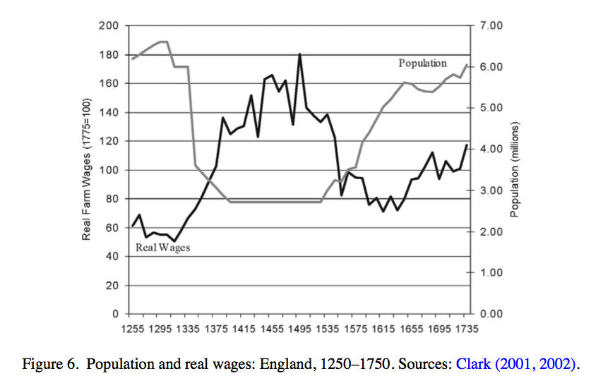
Module 3 · Production · Short Run
Famous Example for Diminishing Marginal Returns
The (agriculture-based) economy before 1800:
Land was the fixed factor; labor was variable
Q = f (labor, land); no capital
Wages and population, England 1300-1500
In 1348, the Black Death killed almost half the population (labor).
→ What happened to the return to labor?
Population
Return to labor
Management 405 · Module 3 · Production and Costs
17
Notes:
A favorite historical example. The Black Death killed roughly 40% of Europe's labor force in the 14th century. Wages of survivors rose sharply – consistent with their (now higher) marginal product. Real-world proof of marginal-product reasoning, 600 years before economists named it.

Slide 18
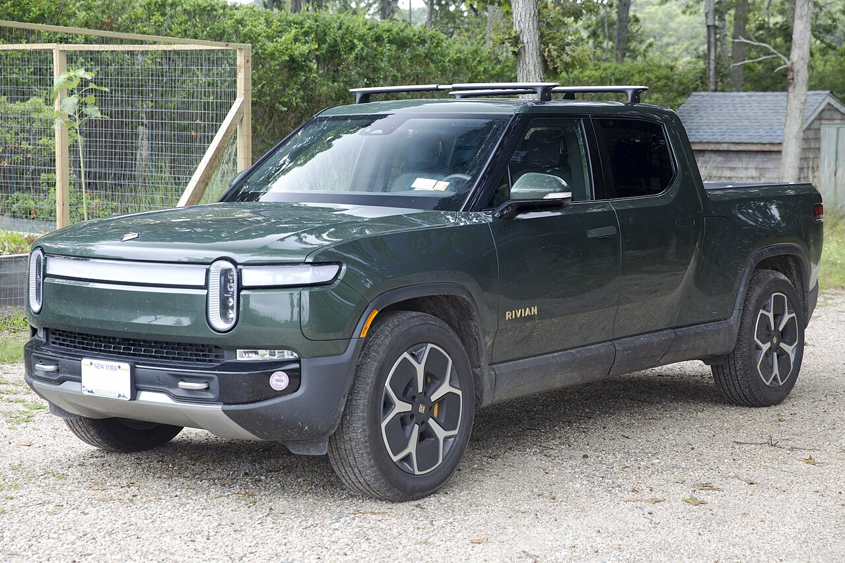
Module 3 · Production · Short Run
Hiring Decisions in the Short Run — Context & Scenario
Demand and output price are given
Large number of R1 ordered at price of ~$80k
Out of this, ~$35k is material cost → (Net) Revenue per car ~$45k
Short run: capital (factory size, robots) is fixed
The only way to expand production is to hire more workers
Rivian R1 (CC BY-SA, Wikimedia)
→ How many workers should Rivian optimally hire?
Management 405 · Module 3 · Production and Costs
18
Notes:
Setup for the next several slides. We'll derive Rivian's optimal hiring level. Given: Rivian R1 sells at ~$80K (average transaction price reported by Rivian for 2024–25), and capital (the plant and robot count) is fixed in the short run. Materials and other variable costs are deliberately set aside here – we handle them on the cost side of the module. Question: how many workers should Rivian hire?

Slide 19
Module 3 · Production · Short Run
Hiring Decisions in the Short Run — Core Concept
In the short run (capital K fixed):
MRPL = Marginal Revenue Product of Labor
the extra revenue from one more worker
Decomposition: MRPL = MR × MPL
MR: marginal revenue from selling an extra item
MPL: extra output (marginal product) from hiring one more worker
• When MPL falls, MRPL falls
• Decreasing MPL ⇒ marginal (additional) hires produce less and less additional output
• Price-taker case: MR = P, so MRPL = P × MPL
→ Even when holding MR (or price) constant, MRPL falls when labor is added, as a result of falling MPL
MB > MC
(of labor)
→ Hire more
Decision rule: If MRPL > w (wage), hire more workers
Management 405 · Module 3 · Production and Costs
19
Notes:
MRPL — Marginal Revenue Product of Labor. In plain terms: how much extra revenue does one more worker produce? The textbook definition is MR × MPL — marginal revenue per unit times the marginal product of labor. For a firm small enough that one more truck doesn't move the market price (price-taker), MR ≈ P, so MRPL ≈ P × MPL. Since MPL falls as L grows (diminishing returns), MRPL also falls — which is why every firm has a finite optimal hiring level. We're staying in the short run here: capital K is fixed, so the only lever is L. Materials and other variable costs come back in the cost-side of the module.

Slide 20
Module 3 · Production · Short Run
Example: Calculate MRPL at 2,300 Employees and 100 Robots
K (robots)
Currently 100 robots and 2,300 employees on the R1 line
(Net) Revenue per car ~$45k
Assume that this is approx. constant
What is MRPL? (in $ per worker, per week)
 | 100 | 200 | 300 | 400
0 | 0 | 0 | 0 | 0
250 | 165 | 234 | 286 | 331
500 | 204 | 288 | 353 | 407
1,000 | 251 | 354 | 434 | 501
1,500 | 283 | 400 | 490 | 566
2,000 | 309 | 436 | 534 | 617
2,500 | 330 | 467 | 571 | 660
3,000 | 348 | 493 | 604 | 697
3,500 | 365 | 516 | 632 | 730
4,000 | 380 | 537 | 658 | 760
4,500 | 394 | 557 | 682 | 787
5,000 | 406 | 574 | 703 | 812
L (workers)
Production-function table (link)
Discussion Break
Management 405 · Module 3 · Production and Costs
20
Notes:
Anchor the concept with a concrete scenario. At 2,300 workers and 100 robots, ask students first to find which interval in the production-function table contains L = 2,300 — that's 2,000 → 2,500 per our MPL convention. Then reframe the per-car return: of the $80k price, about $35k is material cost, so the net revenue per car is roughly $45k. Assume this is approximately constant across quantity, so MRPL ≈ (Net Revenue) × MPL.

Slide 21
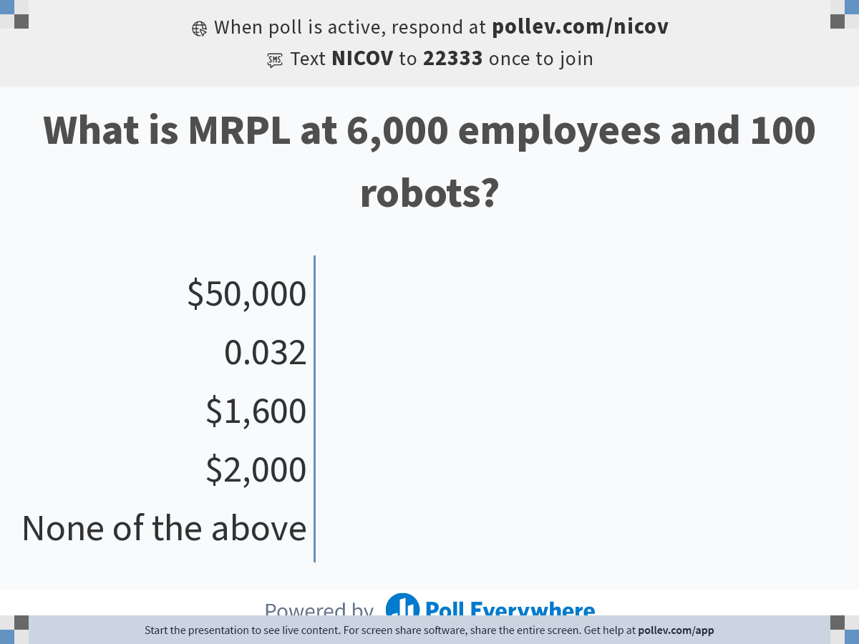
Module 3 · Production · Short Run
What Is Rivian's MRPL at 2,300 Employees?
POLL
Respond at PollEv.com/nvoigtlaender
Management 405 · Module 3 · Production and Costs
21
Notes:
Quick PollEv – compute the MRPL at 2,300 employees and submit. Give them 30 seconds. The point isn't the exact number; it's to make sure everyone identifies the right interval (2,000 → 2,500) and does the calculation in their head.

Slide 22
Module 3 · Production · Short Run
Solution: MRPL of Rivian
Check which interval contains the current workforce (L = 2,300)
→ use the 2,000 → 2,500 step
From the production-function table (link):
Q (2,000) = 309 R1 per week
Q (2,500) = 330 R1 per week
Compute MPL = ΔQ / ΔL
MPL = (330 − 309) / 500 = 0.042 cars per worker per week
MRPL = MPL × MR
MR per car (net of material costs) is ≈ $45,000
→ Solution: MRPL = 0.042 × $45,000 = $1,890 per worker per week
Management 405 · Module 3 · Production and Costs
22
Notes:
Reveal the answer step by step. Step 1: ask which interval contains L = 2,300 — answer 2,000 → 2,500, because our MPL convention always computes ΔQ / ΔL over a full table interval. Step 2: pull Q(2,000) = 309 and Q(2,500) = 330 from the production-function table at K = 100 robots. Step 3: apply the convention — ΔQ = 21, ΔL = 500, so MPL ≈ 0.042 cars per worker per week. Step 4: MRPL = MPL × MR. MR per car is the net revenue after material cost (~$80k price − ~$35k materials = ~$45k), so MRPL ≈ 0.042 × $45,000 ≈ $1,890 per worker per week. The most common slip is comparing MRPL to the TOTAL wage bill instead of the weekly wage of ONE more worker.

Slide 23
Module 3 · Production · Short Run
The Optimal Hiring Rule in the Short Run
Should Rivian hire more workers?
Suppose the weekly wage (incl. benefits) is $1,500 per worker
Hiring one more worker:
Revenue rises by MRPL
Wage bill rises by w
Profit rises whenever MRPL > w
Optimum: hire L* where MRPL = w
L*
MB = MC
(of labor)
Optimal Number of Workers: L* where: MRPL = w
Management 405 · Module 3 · Production and Costs
23
Notes:
The same rule, in algebra: MRPL = w at the optimum. Burn this into your brain. Every short-run hiring problem you encounter as an executive is some version of this comparison.

Slide 24
Module 3 · Production · Short Run
Optimal Hiring Rule in the Short Run: Numerical Solution
▪ Compute MRPL for each L-interval (0-250, 250-500, 500-1,000…)
L | K | Q | ΔQ | ΔL | MPL | MRPL
0 | 100 | 0
250 | 100 | 165
500 | 100 | 204
1,000 | 100 | 251
1,500 | 100 | 283
2,000 | 100 | 309
2,500 | 100 | 330
3,000 | 100 | 348
3,500 | 100 | 365
4,000 | 100 | 380
4,500 | 100 | 394
5,000 | 100 | 406
Wage
165
250
0.660
$29,700
$1,500
39
250
0.156
$7,020
$1,500
47
500
0.094
$4,230
$1,500
32
500
0.064
$2,880
$1,500
26
500
0.052
$2,340
$1,500
21
500
0.042
$1,890
$1,500
18
500
0.036
$1,620
$1,500
17
500
0.034
$1,530
≈
$1,500
Optimal hiring falls into the interval between 3,000 and 3,500 workers.
15
500
0.030
$1,350
$1,500
14
500
0.028
$1,260
$1,500
12
500
0.024
$1,080
$1,500
MB ≈ MC
(of labor)
$$MRPL = \$45,000 × MPL$$
Management 405 · Module 3 · Production and Costs
24
Notes:
Numerical solution to the optimal-hiring rule. Re-use the MPL values from slide 14, multiply each by the net revenue per car ($45k, established on slide 19) to get MRPL. Compare each interval's MRPL against the weekly wage of $1,500. The optimum is the interval just BEFORE MRPL falls below the wage — here, somewhere between L=3,000 and L=3,500 if we extended the table, but for the 0–2,500 range every MRPL above $1,890 still exceeds the wage, so we'd keep hiring.

Slide 25
Module 3 · Production · Wage Searchers
The Case of Wage Searchers
So far, we've assumed wages are constant
Realistic for a small firm hiring at the market wage
For a large firm (relative to the local labor market), hiring more workers can push the wage up
Example: a local hospital hiring highly specialized surgeons
Example: a frontier AI lab adding 100 senior researchers in one year
Term: the firm is a wage searcher (not a wage taker)
the wage rate is upward-sloping in employment
The true marginal cost of labor includes the wage-bid-up effect
Management 405 · Module 3 · Production and Costs
25
Notes:
We've been assuming wages are constant — fine for a small firm hiring at the market wage. But a large employer (relative to the local labor market) hiring many workers pushes the wage up. Two concrete examples: a regional hospital hiring specialized surgeons can't just pay the market wage when it adds 20 of them; a frontier AI lab adding 100 senior researchers in one year drives up the going rate. The technical term is monopsony, but you don't need the word — the intuition is enough. Call such a firm a wage searcher (not a wage taker): the wage rate is upward-sloping in employment. Punchline at the bottom: the TRUE marginal cost of labor includes the wage-bid-up effect — when you hire one more, you typically have to bump everyone else's wage too.

Slide 26
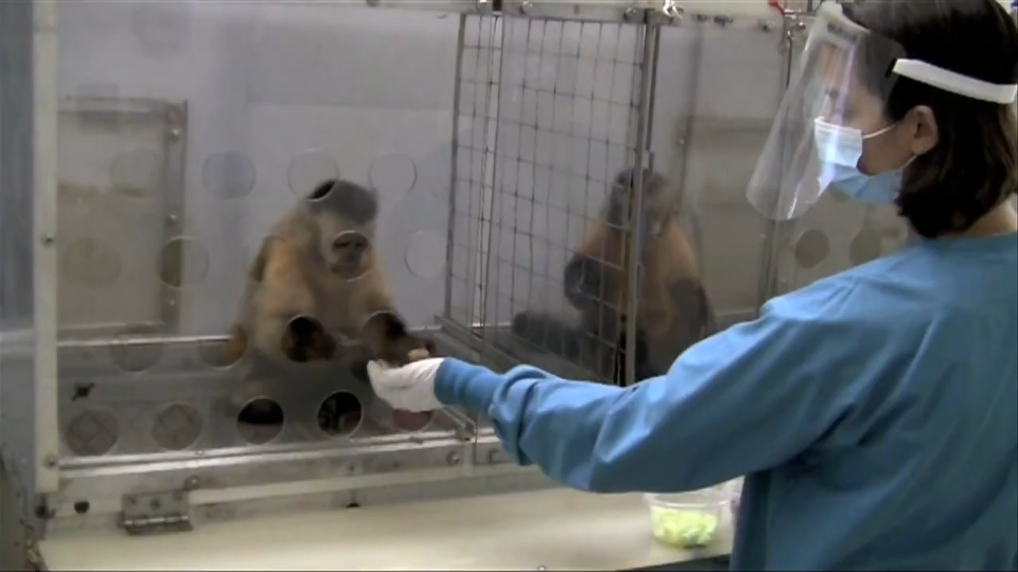
Module 3 · Production · Wage Searchers
Wage Searcher Caveat: Nobody likes being treated unequally…
Management 405 · Module 3 · Production and Costs
26
Notes:
Real wage data across firms of different sizes. The pattern – larger firms tend to pay more – is consistent with the wage-search story, though many other things matter too (productivity, location, benefits).

Slide 27

Module 3 · Production · Wage Searchers
Example: The Full Cost of Poaching an AI Researcher
Anthropic is trying to poach a star researcher from Google DeepMind
She would join Anthropic for a $5M annual salary
Anthropic already employs 2 star researchers, each earning $3.5M
If the new researcher is hired, the existing two will demand the same salary
→ What is the marginal cost of the 3rd researcher?
Demis Hassabis (CC BY, C. Michel via Wikimedia)
Discussion Break
Management 405 · Module 3 · Production and Costs
27
Notes:
A torn-from-the-headlines wage-search example. Anthropic wants to poach a star researcher from Google DeepMind. She's rare; the third hire requires bumping up the existing senior researchers too. So the third hire is way more expensive than her salary alone. The 2024-2026 AI talent wars are the textbook wage-searcher story.

Slide 28
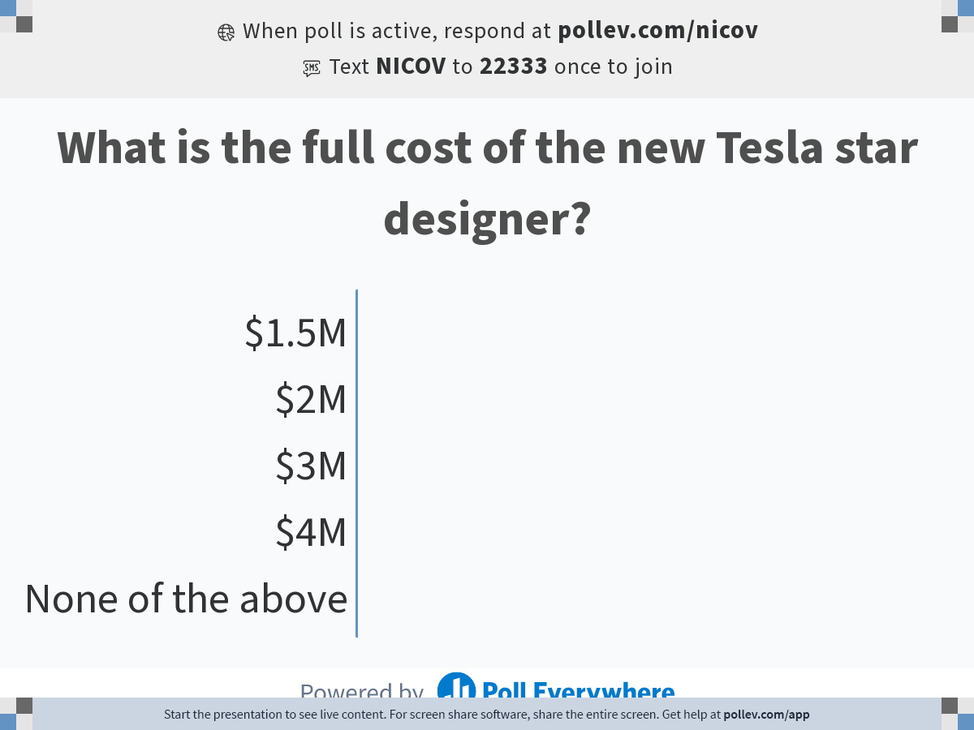
Module 3 · Production · Wage Searchers
What Is the Full Marginal Cost of the New Researcher?
POLL
Management 405 · Module 3 · Production and Costs
28
Notes:
PollEv – what's the full marginal cost of the new researcher? Watch for the common trap of just reporting her $5M salary; the real answer includes the raises paid to researchers 1 and 2.

Slide 29
Module 3 · Production · Wage Searchers
Solution: Marginal Cost of the 3rd Researcher = $8M
The star researcher herself is paid $5M
The two existing researchers each get a raise of ($5M − $3.5M) = $1.5M
Total extra wage bill: $5M + 2 × $1.5M
Full Marginal Cost of the 3rd researcher = $8M
Take-Away: Big buyers of scarce talent can affect wages — factor it in
Management 405 · Module 3 · Production and Costs
29
Notes:
Reveal: marginal cost of the third researcher is $8M, not her $5M salary. The lesson: when you're a big enough buyer of scarce talent (or anything), your hiring moves the market price. Factor that in. The same logic applied at Meta when they paid up to keep AI researchers from leaving in 2024.

Slide 30
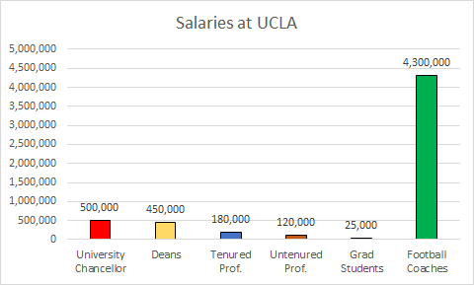
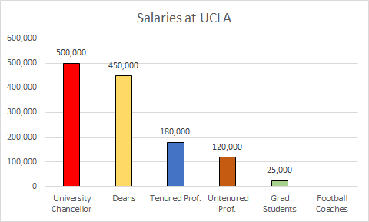
Module 3 · Production · Wage Searchers
Are Real-World Wages = MRPL?
Search tool: https://ucannualwage.ucop.edu/wage/
Management 405 · Module 3 · Production and Costs
30
Notes:
The empirical question that closes this section. Do real-world wages roughly equal MRPL? The UC wage-comparison tool lets you check for yourself. Spoiler: yes, broadly, but with persistent gaps that economists still argue about.

Slide 31
Module 3 · Agenda
Part 1.c: Long Run – Choosing the Right Input Mix
Part 1: Production – Picking the Right Inputs
Production Function
Short Run – Hiring Decisions
Long Run – Optimal Input Mix
Part 2: Costs – Producing at the Lowest Price
Cost Concepts
Scale & Scope
Management 405 · Module 3 · Production and Costs
31
Notes:
Switching gears now from short run to long run. In the long run, capacity is no longer fixed – we get to choose K AND L from scratch. New decision: what's the right MIX of capital and labor?

Slide 32
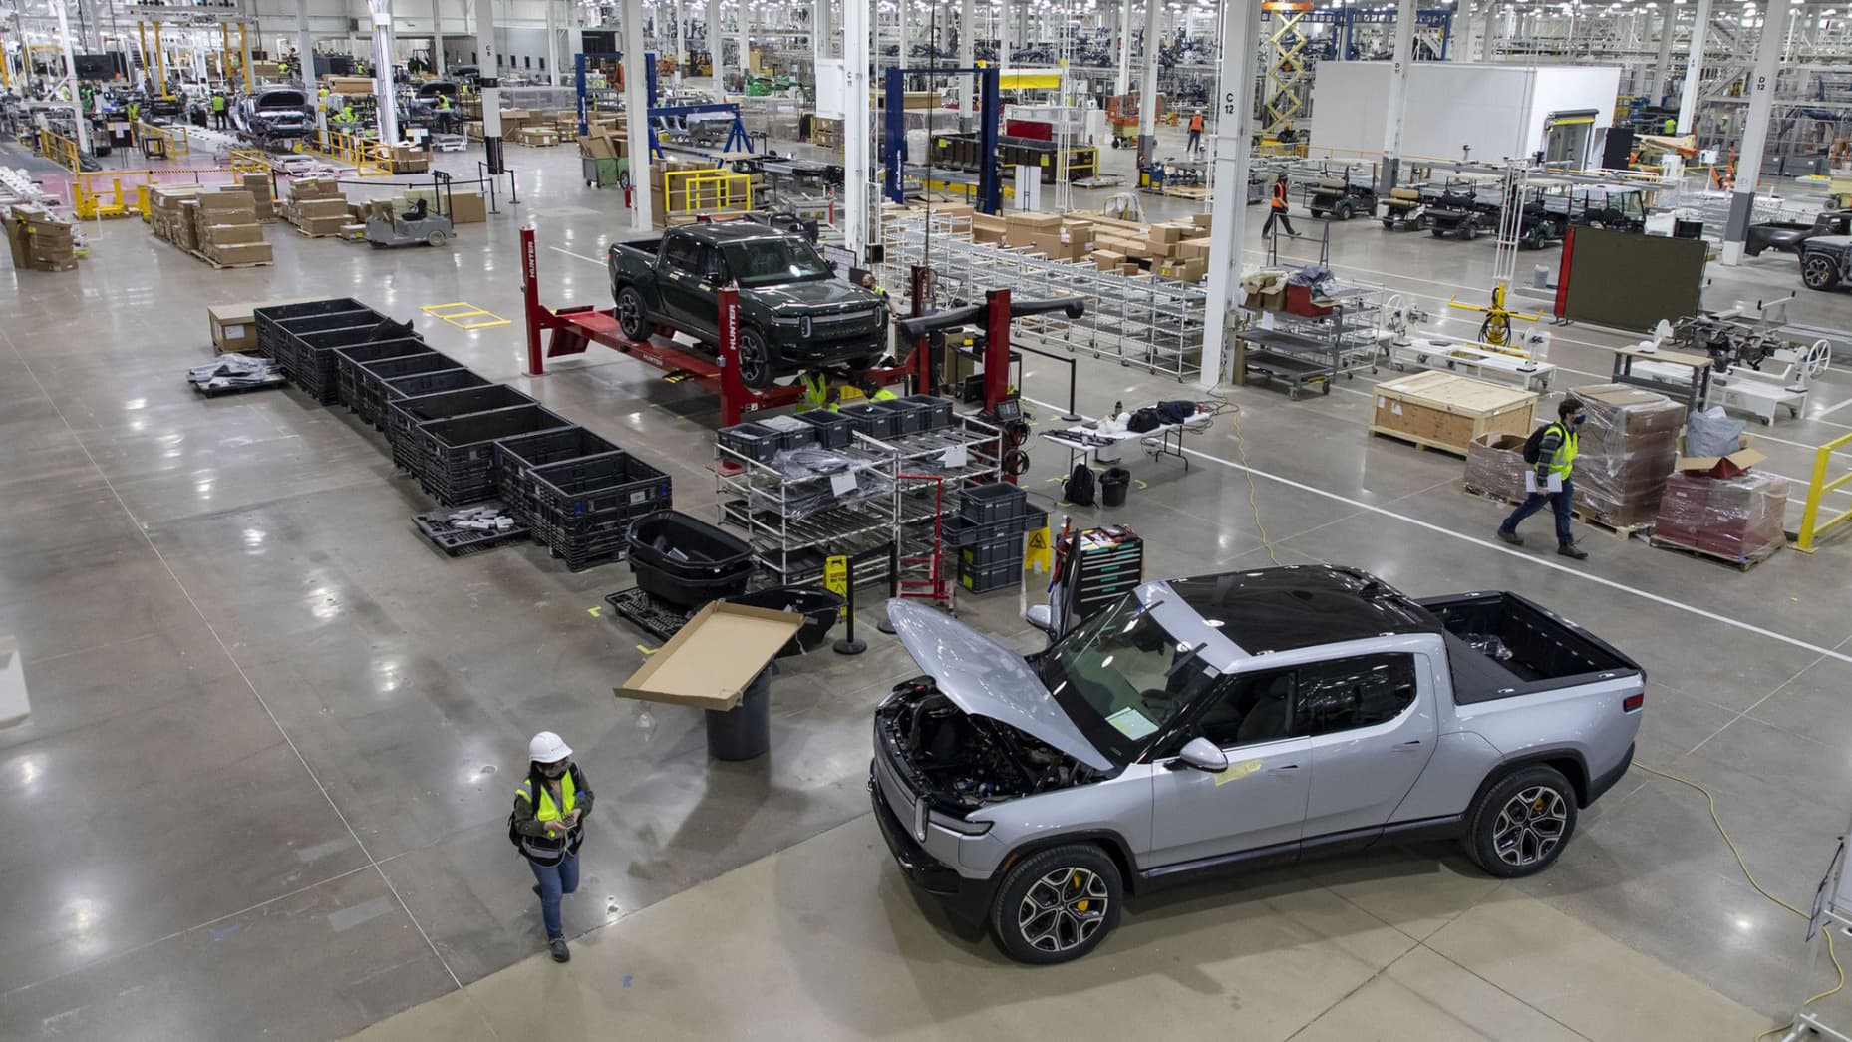
Module 3 · Production · Long Run
Long Run: Rivian Builds a New Georgia Plant
Context: Rivian builds its new Georgia plant
Both capital and labor are flexible inputs
What is the optimal input mix?
E.g., robots (K) and workers (L)
We will:
Use marginal analysis
Learn a simple rule for the optimal combination of inputs
Brian Cassella | Tribune News Service | Getty Images
Long run ⇒ pick the optimal K-and-L mix
Management 405 · Module 3 · Production and Costs
32
Notes:
Concrete setup: Rivian building its new plant in Stanton Springs, Georgia (recently revived after the VW partnership in 2024). They get to pick everything – plant size, machinery, workforce, layout. How should they choose?

Slide 33
Module 3 · Production · Long Run
Optimal Combination of Inputs
Optimal Input Mix: How much K and how much L?
Decision rule for the long run:
$$\frac{{MP}_{K}}{p_{K}} = \frac{{MP}_{L}}{w}$$
MP_{K} : Marginal Product of Capital
MP_{L} : Marginal Product of Labor
pₖ : Price of Capital
w : Wage
Bang for the Buck Rule
Holds when both L and K are flexible
Refers to a given output quantity Q
Assumes input prices w and pₖ are constant
PDF
SEE TEACHING NOTE → Bang-for-the-Buck Rule
Management 405 · Module 3 · Production and Costs
33
Notes:
The general framework: we need a decision rule for combining inputs when both are variable. The rule will look familiar – it's the same logic as the short-run hiring rule, generalized. Three conditions under the rule: both inputs flexible, output Q held fixed, input prices w and p_K constant. Spend each additional dollar on whichever input gives the most extra output per dollar.

Slide 34
Module 3 · Production · Long Run
Applying the 'Bang for the Buck' Rule
('recipe' for exams)
How to adjust L and K in order to produce a given quantity at lower cost
If $\frac{{MP}_{L}}{w}$ > $\frac{{MP}_{K}}{p_{K}}$ → use more L and less K
Decreasing marginal returns imply:
Due to increased L, ${MP}_{L}$ will fall as L increases
Due to reduced K, ${MP}_{K}$ will rise as L increases
If $\frac{{MP}_{L}}{w}$ < $\frac{{MP}_{K}}{p_{K}}$ → use less L and more K
…continue to adjust until $\frac{{MP}_{L}}{w} = \frac{{MP}_{K}}{p_{K}}$
Management 405 · Module 3 · Production and Costs
34
Notes:
Recipe for applying the rule. Two cases when the MP-per-dollar ratios are not yet equal: if MP_L/w is the higher one, the firm should shift toward labor (use more L, less K); if MP_K/p_K is higher, shift toward capital. As the adjustment happens, diminishing marginal returns kick in — adding L pulls MP_L down, taking K away pushes MP_K up — so the two ratios converge. Keep going until they meet: MP_L/w = MP_K/p_K is the optimum.

Slide 35
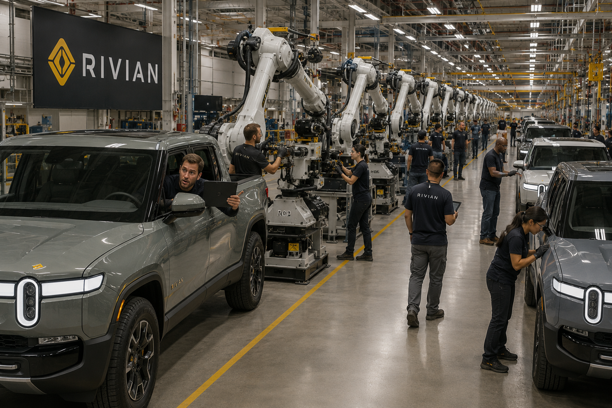
Module 3 · Production · Long Run
Example: Rivian's New Georgia Plant
Rivian is building a new plant in Stanton Springs, Georgia
They ask for your advice on the optimal mix of robots and workers
You know:
Current plan: 300 robots and 2,000 workers
Weekly wage for suitable workers: w = $1,200
Cost of one robot (per week): pₖ = $20,000
Is Rivian's 300 robots / 2,000 workers plan optimal?
Discussion Break
Management 405 · Module 3 · Production and Costs
35
Notes:
Rivian announced a second US assembly plant in Stanton Springs, Georgia – a multi-billion-dollar project meant to add capacity once it ramps. We'll apply the bang-for-the-buck rule to a stylised version of those plans: robots vs. workers, given each input's price and marginal product. Current plan is K = 300 robots and L = 2,000 workers — both on the production-function table grid, so the next slides read Q, MPL, MPK straight off the table. The strategic point: when the two MP/price ratios aren't equal, the firm should reallocate.

Slide 36
Module 3 · Production · Long Run
Is Rivian's Current Plan Optimal? (Production Function)
The production function at Rivian's new plant:
Current mix: 300 robots, 2,000 workers
Let's derive the “ingredients” for the bang-for-the-buck rule
Convention: use the next-higher input level (Δ goes forward)
Labor: MPₗ = ΔQ / ΔL = (571 − 534) / (2,500 − 2,000) = 0.07
Robots: MPₖ = ΔQ / ΔK = (617 − 534) / (400 − 300) = 0.83
Now: Check if Rivian's proposed choice is optimal (PollEV)
K (robots)
 | 100 | 200 | 300 | 400
0 | 0 | 0 | 0 | 0
250 | 165 | 234 | 286 | 331
500 | 204 | 288 | 353 | 407
1,000 | 251 | 354 | 434 | 501
1,500 | 283 | 400 | 490 | 566
2,000 | 309 | 436 | 534 | 617
2,500 | 330 | 467 | 571 | 660
3,000 | 348 | 493 | 604 | 697
3,500 | 365 | 516 | 632 | 730
4,000 | 380 | 537 | 658 | 760
4,500 | 394 | 557 | 682 | 787
5,000 | 406 | 574 | 703 | 812
L (workers)
Production-function table (link)
POLL
Management 405 · Module 3 · Production and Costs
36
Notes:
The production function for Georgia in numbers. At K = 300, L = 2,000 the table reads Q = 534. Walk through the derivation: by convention we step UP to the next grid value (2,000 → 2,500 for labor, 300 → 400 for robots), so MPL = (571 − 534)/500 ≈ 0.07 cars per worker per week and MPK = (617 − 534)/100 ≈ 0.83 cars per robot. Don't reveal whether the mix is optimal yet — the next slide is the PollEV.

Slide 37
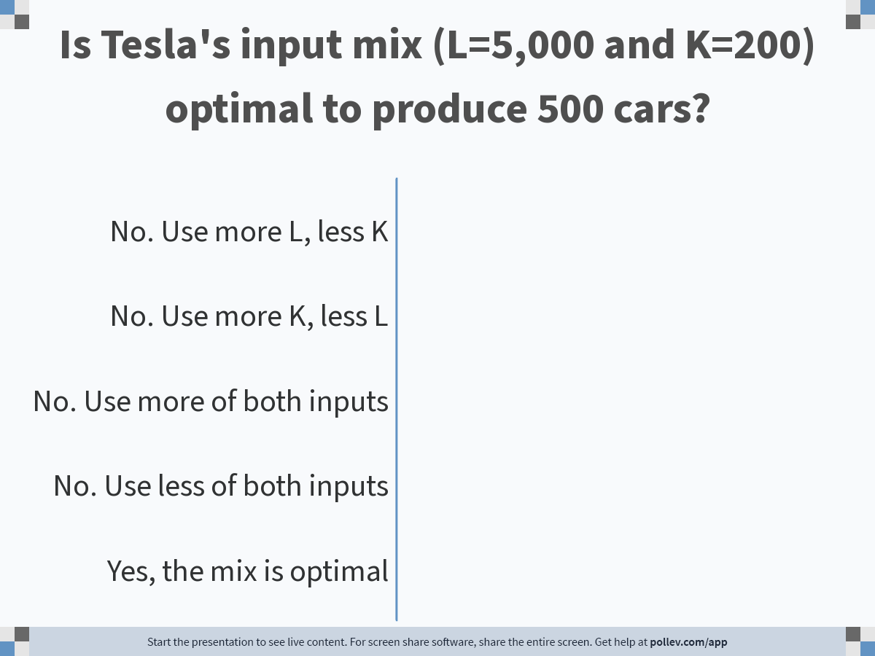
Module 3 · Production · Long Run
Is Rivian's Input Mix Optimal?
POLL
Respond at PollEv.com/nvoigtlaender
Management 405 · Module 3 · Production and Costs
37
Notes:
Quick PollEv. Looking at the numbers from the previous slide — current plan K = 300 robots, L = 2,000 workers (Q = 534), with MPL ≈ 0.07 and MPK ≈ 0.83 — is the current mix optimal? Give them 30 seconds to think through the bang-for-the-buck ratios (MP / price). Some will say yes, some no; reveal in the next slide. The point isn't the vote count, it's the active calculation.

Slide 38
Module 3 · Production · Long Run
Solution: The Optimal Input Mix
MP
Price
MP per $
Robots (K)
≈ 0.83 cars
$20,000
0.000042 cars / $
Workers (L)
≈ 0.07 cars
$1,200
0.000058 cars / $
$$\frac{{MP}_{L}}{w} > \frac{{MP}_{K}}{p_{K}}$$
Thus:
→ Rivian should hire more workers, fewer robots
Management 405 · Module 3 · Production and Costs
38
Notes:
Reveal: the mix isn't optimal. Workers' bang-for-the-buck (MPL / w ≈ 5.8 × 10⁻⁵) is roughly 1.4× robots' (MPK / pK ≈ 4.2 × 10⁻⁵), so Rivian should hire more workers and use fewer robots. Intuition: at K = 300, L = 2,000 the marginal worker delivers more output per dollar than the marginal robot — robots are relatively over-priced for the current labor force. Same bang-for-the-buck rule as before; the conclusion direction depends on where the operating point sits.

Slide 39
Module 3 · Production · Long Run
When Prices Change, the Input Mix Shifts
What's the effect on the optimal input mix if…
The government introduces a high tax on robots
Labor unions demand significantly higher wages
$$p_{K}↑ ⇒ \frac{{MP}_{K}}{p_{K}} ↓$$
$$w↑ ⇒ \frac{{MP}_{L}}{w}↓$$
→ shift toward more labor
→ shift toward more automation
When input prices change, the optimal mix shifts toward the input that has become cheaper
Management 405 · Module 3 · Production and Costs
39
Notes:
Comparative statics. When input prices change, the optimal mix shifts: a tax on robots pushes Rivian toward more labor; rising wages push them toward more automation. Real strategic implications for any firm facing input-price shocks – including AI labs deciding between GPU spend and engineer headcount.

Slide 40


Module 3 · Production · Long Run
“Bang for the Buck” in Grocery Shopping
P&G offers two sizes for its flagship detergent
Small Tide Ultra Oxi (29 loads) for $17
Large Tide Ultra Oxi (81 loads) for $35
$$\frac{{MP}_{small}}{p_{small}} = \frac{29}{17} = 1.7$$
$$\frac{{MP}_{large}}{p_{large}} = \frac{81}{35} = 2.3$$
$$\frac{{MP}_{small}}{p_{small}} < \frac{{MP}_{large}}{p_{large}}$$
Bang-for-the-buck: a universal decision rule
Management 405 · Module 3 · Production and Costs
40
Notes:
The bang-for-the-buck rule isn't just for factories – you apply it every week at the grocery store. P&G offers two sizes of Tide Ultra Oxi: small at 29 loads for $17, large at 81 loads for $35. Compute loads-per-dollar: 29/17 ≈ 1.7 for the small, 81/35 ≈ 2.3 for the large. The large size delivers more cleaning per dollar, so the bang-for-the-buck rule says to buy the large bottle. Same logic as the factory's input choice, just a different decision.

Slide 41
Module 3 · Agenda
Part 2: Costs – Producing at the Lowest Price
Part 1: Production – Picking the Right Inputs
Production Function
Short Run – Hiring Decisions
Long Run – Optimal Input Mix
Part 2: Costs – Producing at the Lowest Price
Cost Concepts
Scale & Scope
Management 405 · Module 3 · Production and Costs
41
Notes:
Part 2 – Costs. We've covered what to PRODUCE; now we cover what it COSTS, and crucially, which costs actually matter for decisions.

Slide 42
Module 3 · Costs · Cost Concepts
Three Cost Types
Variable Costs
Fixed Costs
Sunk Costs
Depend on volume produced (Q)
→ Always consider!
Do not depend on quantity produced (Q)
→ Consider for long-run decisions
(entry, exit, capacity)
A fixed cost that
cannot be recovered → Ignore!
Examples
• Buy raw materials
• Hire workers
• Shipping & packaging
Examples
• Rent / lease payments
• Insurance & property tax
• R&D investments (for future innovation)
Examples
• Past R&D
• Past advertising
• Non-refundable deposits
Sunk costs should not affect managerial decisions
Management 405 · Module 3 · Production and Costs
42
Notes:
The single most important cost concept for executives, in five words: sunk costs are not costs. They've already been spent; they cannot be recovered. Any forward-looking decision should ignore them. Period.

Slide 43
Module 3 · Costs · Cost Concepts
Group Work: Your Car or the Company Car?
For a business trip, you can use:
Your own car
→ you are reimbursed 50¢ / mile
Company car
(full cost incl. charge paid by your company)
Costs associated with your car (per mile driven):
20¢ insurance
20¢ maintenance
15¢ electricity
45¢ lease on the vehicle
⇒ Should you use your own car or the company car?
Discussion Break
Management 405 · Module 3 · Production and Costs
43
Notes:
A group-work exercise. Two cars, same daily operating cost, but different sunk amounts. Which should you drive today? Whatever your gut says, the answer is: ignore the sunk cost – it's the same either way (the lease is sunk; only the variable per-mile costs matter for the marginal trip decision).

Slide 44

Module 3 · Costs · Cost Concepts
Why Studios Finish Movies They Know Lose Money
Waterworld (1995)
Management 405 · Module 3 · Production and Costs
44
Notes:
Hollywood case. Kevin Costner's Waterworld – they knew it would flop, why release it anyway? Answer: even a flop adds revenue net of marketing/release costs. The hundreds of millions already spent on production are sunk. Decision should be forward-looking only.

Slide 45
Module 3 · Costs · Cost Concepts
Waterworld: Sunk Costs and Decisions over Time
June 1994
September 1994
December 1994
Expected Revenues ($M)
150
150
150
Sunk Cost ($M)
16
100
140
Expected Additional Cost ($M)
84 (<150)
40 (<150)
35 (<150)
Overall Cost (incl. sunk) ($M)
100
140
175
Expected Profit ($M)
+50
+10
−25
Decision
Make the film!
Make the film!
Make the film!
Ignore sunk costs — continue whenever Expected Revenue > Expected Additional Cost
Management 405 · Module 3 · Production and Costs
45
Notes:
The decision tree behind the Waterworld decision. Three scenarios – optimistic, neutral, pessimistic – differ in how much was sunk vs. how much more it costs to release. In ALL three the release-anyway revenue exceeds the marginal release cost. So they released. Sunk costs are sunk.

Slide 46

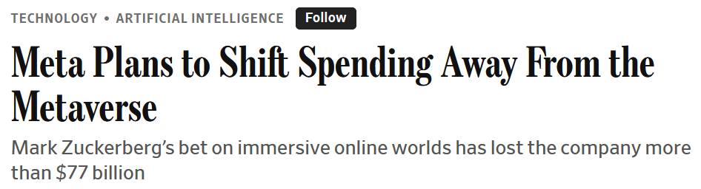
Module 3 · Costs · Cost Concepts
Modern Sunk Cost: Meta's Reality Labs Has Lost $70B+
Meta poured ~$70B into Reality Labs since 2020
Quest headsets, Horizon Worlds – thin adoption, little revenue
Hardware/software still not commercially viable – payoff keeps slipping
Wall Street kept asking when it pays off
In 2026: Decision to shift spending to AI
→ Classic sunk-cost discipline, 2020s edition
Management 405 · Module 3 · Production and Costs
46
Notes:
The same Waterworld logic, in a current strategic context. Meta has poured roughly $70B – the Wall Street Journal puts the figure north of $77B – into Reality Labs since 2020. Quest headsets and Horizon Worlds never crossed into mass adoption, and the AR/VR hardware-and-software stack still is not commercially viable. Wall Street kept asking when it pays off, and forward-looking returns kept getting pushed out. In 2026 Meta made the call to shift incremental spending toward AI – higher MPL on the next dollar, regardless of how many billions had already been spent on Reality Labs. Classic sunk-cost discipline, 2020s edition.

Slide 47

Module 3 · Costs · Cost Concepts
Sunk Cost & Opportunity Cost: Apple's Canceled Apple Car
Apple killed Project Titan in 2024 after ~10 years and ~$10B spent
Sunk costs not a reason to keep going
Real reason to stop: opportunity cost of capital + 2,000 engineers
Reallocated → AI / Apple Intelligence (with higher expected returns)
Vanarama Apple Car concept (fair use, © Vanarama)
Opportunity cost = the next-best alternative use for the same dollars & engineers
Management 405 · Module 3 · Production and Costs
47
Notes:
Apple killed Project Titan in 2024 after roughly a decade and $10B spent on the car. The slide makes two cost points at once. First, the sunk costs are sunk – $10B already spent is not a reason to keep going. Second, the real reason to stop was opportunity cost: the capital and the ~2,000 engineers had a higher-return use in Apple Intelligence and the AI stack. Reallocation, not refusal-to-cut-losses, is the executive lesson. Opportunity cost is the next-best alternative use of the same dollars and engineers.

Slide 48
Module 3 · Costs · Cost Concepts
Dictionary of Costs
Cheat sheet to refer back to
Total Cost
Average Cost
Marginal Cost
$$TC = TFC + TVC$$
$$ATC = \frac{TC}{Q}$$
$$MC = \frac{ΔTC}{ΔQ}$$
TFC = Total Fixed Cost
(ignore sunk costs)
TVC = Total Variable Cost
AFC = TFC / Q
AVC = TVC / Q
ATC = AFC + AVC
= ΔTVC / ΔQ (TFC is constant)
Derivative form:
MC = dTC / dQ
= dTVC / dQ
Management 405 · Module 3 · Production and Costs
48
Notes:
Quick reference: fixed, variable, sunk, marginal, average, opportunity. A cheat sheet you'll refer to for the rest of the module. Make sure you can give a one-sentence example of each.

Slide 49
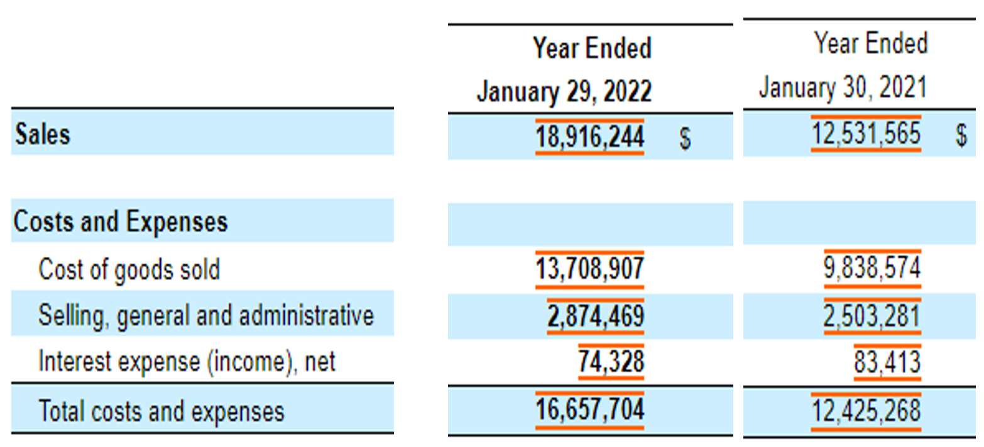
Module 3 · Costs · Cost Concepts
Relationship to Accounting: Ross Stores Annual Report
≈ TVC
Mix FC & VC
Part of FC
≈ TC
Management 405 · Module 3 · Production and Costs
49
Notes:
Ross Stores' annual report, used here to ground the cost concepts in something students will recognise from a 10-K. Walk through the three items under 'costs and expenses': cost of goods sold is essentially variable (≈ TVC); selling, general and administrative is a mix of fixed and variable (sales commissions vary with revenue, the CEO's salary does not); interest expense is fixed (the cost of servicing long-term debt). Everything labelled costs and expenses together is the firm's TC. The red overlays make the mapping visible without rewriting the line items.

Slide 50

Module 3 · Costs · Cost Concepts
Marginal Cost in Action: What Is the MC of a Burn60 Workout?
Poll Everywhere break
Management 405 · Module 3 · Production and Costs
50
Notes:
Real-world setup for the marginal-cost concept. Burn60 (a boutique fitness studio) offers package pricing: 10 classes for $10 each ($100 total) or 20 classes for $8 each ($160 total). The question to put to the room: starting from the 10-pack, what's the marginal cost of the 11th class? Hint: it's not $8. Going from the 10-pack to the 20-pack costs an additional $60 for ten more classes — so the marginal cost of each of those next ten is $6, not the $8 sticker price. Average cost (per-unit price you see advertised) and marginal cost (what one more actually costs) diverge whenever there is volume-tier pricing. We poll the room on the next slide before walking through it.

Slide 51
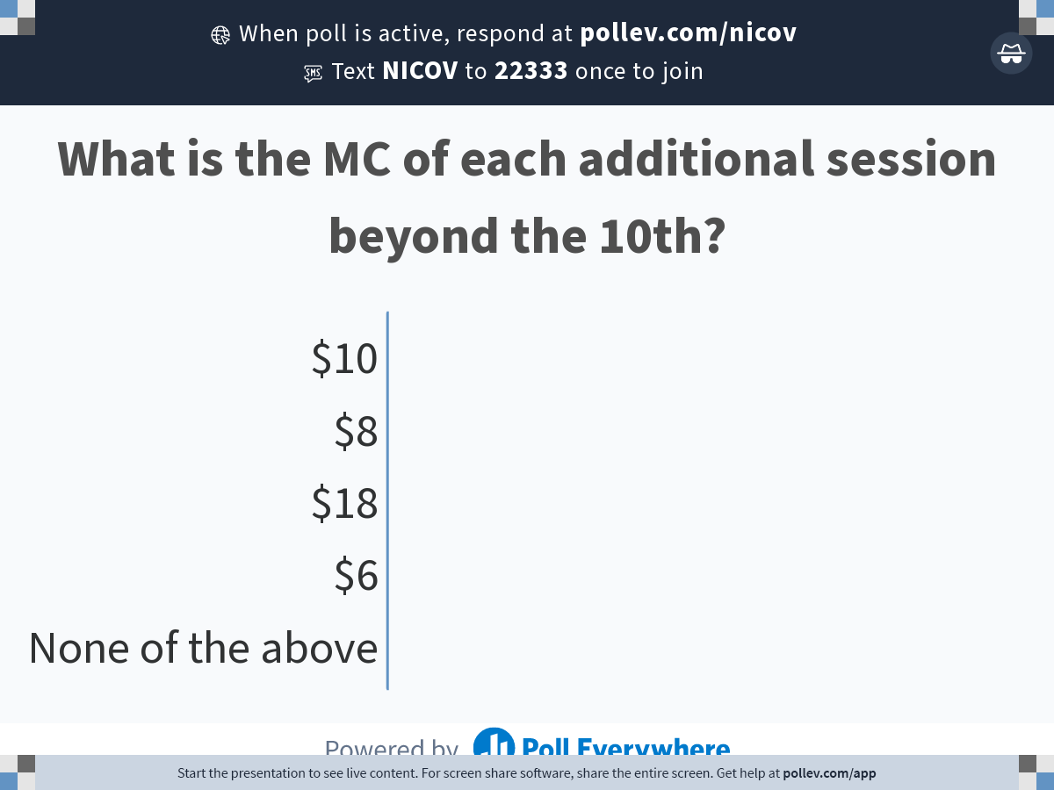
Module 3 · Costs · Cost Concepts
What Is the MC of Each Additional Session Beyond the 10th?
Poll Everywhere break
Respond at PollEv.com/nvoigtlaender
Management 405 · Module 3 · Production and Costs
51
Notes:
Quick PollEv. Compute the marginal cost of each additional Burn60 session when buying the 20-pack instead of the 10-pack. The common trap: students see the $8 per-class rate on the 20-pack and answer $8. But going from the 10-pack ($100 total) to the 20-pack ($160 total) costs $60 more for 10 more sessions — so the MC of each additional session is $6, not $8. The first 10 sessions get re-priced from $10 to $8 as well; that re-pricing is what pulls the marginal cost below the headline 20-pack rate. Give them 30 seconds, then reveal the solution on the next slide.

Slide 52
Module 3 · Costs · Cost Concepts
Solution: MC = $6 / Session
10-class pack ($10 / class)
20-class pack ($8 / class)
TC = 10 × $10 = $100
TC = 20 × $8 = $160
Marginal cost of each additional session beyond the 10th:
MC = ($160 − $100) / 10 = $6 / session
Bigger discount than the sticker: the first 10 sessions also drop from $10 → $8
MC < AC : volume discounts make the marginal session cheaper than the sticker
Management 405 · Module 3 · Production and Costs
52
Notes:
Reveal: MC = $6 per additional session — not the $8 sticker rate on the 20-pack. Total cost goes from $100 (10 classes at $10) to $160 (20 classes at $8), so the next ten cost $60 incremental → $6 per session. The intuition: the 20-pack also re-prices the first ten sessions from $10 down to $8, and that $2 × 10 = $20 of savings on the inframarginal sessions is what pulls the marginal rate below the $8 sticker. Pedagogical point: volume pricing makes the marginal unit cheaper than the headline per-unit rate — the mirror image of the SaaS-tier example where the marginal user is more expensive than the headline rate.

Slide 53
Module 3 · Costs · Cost Concepts
Marginal Cost in Finance: The True Rate on a Bigger Loan
Option 1
Option 2
$100k loan
Extra $10k
$110k loan
at 5% annual interest
at 6% annual interest
%
Annual interest $5,000
%
Annual interest $6,600
≡
Total loan amount $100,000
≡
Total loan amount $110,000
$
Annual interest cost $5,000
$
Annual interest cost $6,600
What is the marginal interest rate on the additional $10k?
($6,600 − $5,000) / $10,000 = 16%
Marginal cost (16%) is much higher than average rate (6%)
Management 405 · Module 3 · Production and Costs
53
Notes:
Same concept applied to finance. Option 1: a $100k loan at 5% costs $5,000 in interest per year. Option 2: a $110k loan at 6% costs $6,600 in interest per year. The marginal interest rate on the extra $10k is the EXTRA interest divided by the EXTRA principal — ($6,600 − $5,000) / $10,000 = 16%. The headline rate of 6% is the AVERAGE; the marginal rate you actually pay for the extra dollars is 16%. This is the common executive trap when comparing loan terms — the rate advertised on the larger loan understates what the marginal dollar truly costs.

Slide 54
Module 3 · Costs · Cost Concepts
Rivian's Georgia Plant — Weekly Cost
Collect data on total cost at different output levels (Q) → Estimate the cost function
$$Estimated cost curve: TC = 10,000,000 + 30,000 · Q + 40 · Q^{2}$$
Fixed Cost
Quadratic term: cost rises faster than output, i.e. marginal cost is increasing
Management 405 · Module 3 · Production and Costs
54
Notes:
Now back to Rivian. Weekly total cost as a function of output Q for the Georgia plant. Fixed cost of $10M, a linear variable component of $30,000 per vehicle, plus a small quadratic term ($40·Q²) that captures the rising marginal cost as production scales up. The scattered dots are observed weekly cost data at different Q levels; the smooth navy curve is the fitted TC function — the same TC = 10,000,000 + 30,000·Q + 40·Q² used in the original deck. Note where the curve crosses Q = 0: that y-intercept is the fixed cost (~$10M).

Slide 55
Module 3 · Costs · Cost Concepts
Rivian's Georgia Plant — Cost Components
Fixed costs dominate at low Q; the quadratic TVC overtakes at scale
Management 405 · Module 3 · Production and Costs
55
Notes:
Decompose total cost into its components: fixed plus variable. Same Rivian cost function used on the previous slide: TC = 10,000,000 + 30,000·Q + 40·Q², so TFC = $10M (the flat gold line at 10) and TVC = 30,000·Q + 40·Q² (the rising red curve). Their vertical sum is the navy TC curve. The visual lets students see how the cost structure shifts as output grows: at low Q, the fixed cost dominates; at high Q, the quadratic TVC term takes over and TC tracks TVC.

Slide 56
Module 3 · Costs · Cost Concepts
Rivian's Georgia Plant — Per-Unit Costs
ATC falls below sales price ($80k) at Q ≈ 250
The minimum of ATC is where it crosses MC
ATC increases again due to rising MC
Management 405 · Module 3 · Production and Costs
56
Notes:
Same Rivian cost function expressed per vehicle. From TC = 10,000,000 + 30,000·Q + 40·Q²: ATC = 10M/Q + 30,000 + 40·Q gives a U-shape (fixed-cost dilution dominates at low Q, the quadratic term takes over at high Q); AVC = 30,000 + 40·Q is linear-rising; MC = 30,000 + 80·Q is linear-rising with twice the slope of AVC. Diagnostic to highlight: MC crosses ATC exactly at the ATC minimum (here Q ≈ 500, value ≈ $70K). The classic U-shape result from any intro micro textbook.

Slide 57
Module 3 · Costs · Cost Concepts
Cost Estimation: What Does an iPhone Cost to Make?
Problem Set Preview
1. What is the AVC of a current-generation iPhone?
2. What is the ATC of a current-generation iPhone?
Hint: estimate each bucket; for AFC, divide the fixed costs of this model by its total lifetime sales
Fixed costs
R&D, marketing, other
$ ?
Material inputs
processor, display, battery, cameras, memory, …
$ ?
Labor
assembly + final test
$ ?
Distribution
stores, logistics, shipping, channel
$ ?
Retail price ≈ $1,200
Tip: you can use AI to research the cost breakdown
Management 405 · Module 3 · Production and Costs
57
Notes:
Problem-set preview. Students leave the lecture with four cost buckets to estimate (fixed costs, material inputs, labor, distribution) and a retail-price anchor of ~$1,200, then research the actual numbers on their own — AI is fine as a research aid. Two deliverables: AVC (sum of the three per-unit buckets — material inputs, labor, distribution) AND ATC (AVC plus AFC). Crucial framing for AFC: fixed costs (R&D, marketing, allocated stores, other) are PER MODEL, allocated over that model's TOTAL LIFETIME sales — not annual sales of all iPhones. For a current iPhone model, lifetime worldwide sales are roughly 200M units, so AFC = TFC_model / 200M. The pedagogical payoff is the comparison of BOTH AVC and ATC to retail price — students will see that even ATC sits well below the sticker.

Slide 58
Module 3 · Costs · Cost Concepts
Solution Sketch: Estimating the iPhone Cost Stack
Fixed costs
$20B
this model (lifetime)
R&D ~$10B, marketing ~$5B, other ~$5B
Material inputs
$430
per iPhone
processor ~$80, display ~$80, memory ~$50, battery ~$10, cameras ~$70, other ~$140
Labor
$30
per iPhone
assembly + final test
Distribution
$20
per iPhone
stores, logistics, shipping, channel
AVC = $430 + $30 + $20 ≈ $480 / iPhone
AFC = $20 B / 200 M iPhones (lifetime) ≈ $100 / iPhone
ATC = AVC + AFC = $480 + $100 ≈ $580 / iPhone
AVC
$480
+ AFC
$100
= ATC
$580
Retail
$1,200
Even ATC sits well below retail — the rest is gross profit margin on each iPhone
Management 405 · Module 3 · Production and Costs
58
Notes:
Walk through the kind of answer an MBA student would hand in for the problem set previewed last slide. Four buckets, order-of-magnitude estimates that basic research lands on: (1) Fixed costs FOR THIS MODEL OVER ITS LIFETIME ~$20B — R&D allocated to this generation ~$10B, marketing ~$5B, other corporate overhead ~$5B. (2) Material inputs ~$430 per iPhone — A-series chip ~$80 plus display ~$80, memory ~$50, battery ~$10, multi-lens cameras ~$70, and the long tail of modem, antennas, housing, packaging ~$140. (3) Labor (assembly + final test) ~$30 per iPhone. (4) Distribution (Apple Retail stores, logistics, shipping, channel) ~$20 per iPhone — stores treated as a distribution-channel cost amortised per unit. Sum the three per-unit buckets → AVC ≈ $480 / iPhone. Critical framing for AFC: divide the model's lifetime TFC by its TOTAL lifetime worldwide sales (~200M units) — NOT by annual sales. AFC ≈ $20B / 200M = $100 / iPhone. ATC = AVC + AFC ≈ $580 / iPhone. Retail ~$1,200 minus ATC ~$580 = ~$620 gross profit margin per iPhone (~52%), consistent with Apple's reported iPhone gross margin in the mid-40% to low-50% range. Pedagogical payoff: even after loading in fixed costs, ATC is roughly half the sticker price — the rest is profit.

Slide 59
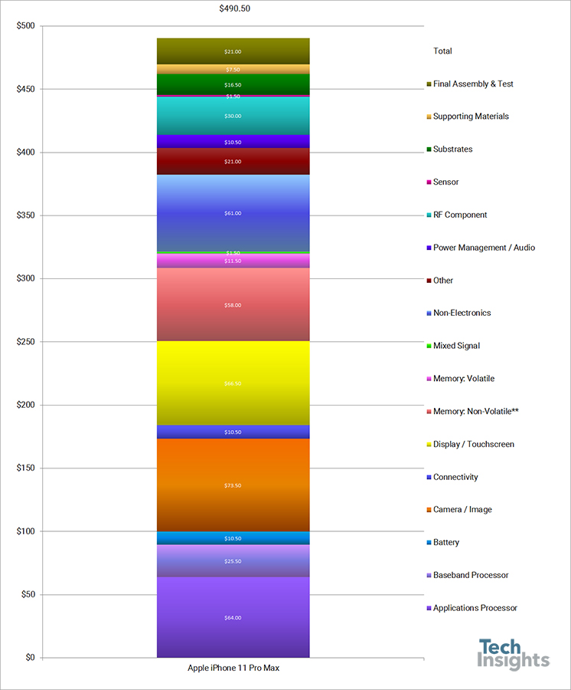
Module 3 · Costs · Cost Concepts
AVC of iPhone 17 ≈ $580
Retail price:
$1,199
Total variable cost (TVC):
≈ $580
Plus missing components:
– Shipping & handling
– Customer service
– Warranty costs
About half of retail goes to fixed-cost recovery, R&D, retail margin
Management 405 · Module 3 · Production and Costs
59
Notes:
Reveal: AVC ≈ $580 for iPhone 17 (vs. ~$1,199 retail). About half of retail. The rest – fixed-cost recovery, gross margin – funds Apple's R&D, retail network, and ecosystem. Students consistently overestimate this number.

Slide 60
Module 3 · Costs · Cost Concepts
Naïve Linear Cost Function: Total Cost View
$ (Total cost)
$$TC = TFC + 500 · Q$$
slope = $500
TFC
Q (quantity produced)
Linear naïve TC : fixed cost + constant marginal cost ($500 / unit)
Management 405 · Module 3 · Production and Costs
60
Notes:
iPhone naïve cost function – total cost as output rises. Linear: a fixed cost plus a constant marginal cost. This is the simplest model of a cost function; we'll see more complex shapes later (capacity constraints, increasing returns).

Slide 61
Module 3 · Costs · Cost Concepts
Naïve Linear Cost Function: Per-Unit View
$ per unit
$$When MC is constant, it equals AVC$$
$$MC = AVC = \$500$$
500
Q (quantity produced)
Per-unit view : constant marginal cost, AC falls as fixed cost spreads
Management 405 · Module 3 · Production and Costs
61
Notes:
Same data, per unit. Note the constant MC and (implicit) declining AC – the classic shape when fixed costs spread over more units. With constant MC, AVC = MC at every Q. AC = AVC + AFC, so AC starts above MC and falls toward it as Q → ∞.

Slide 62
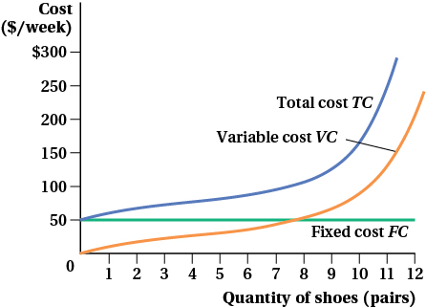
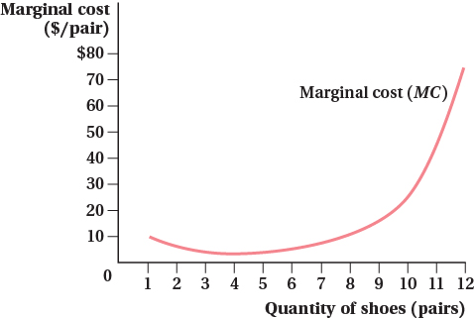
Module 3 · Costs · Cost Concepts
More Complex Cost Functions: When MC Isn't Linear
Total / variable / fixed cost — convex at high Q
Marginal cost — U-shape (high at low + high Q)
Keep MC linear when possible — use the U-shape only when scale really matters
Management 405 · Module 3 · Production and Costs
62
Notes:
Reality check: cost functions can be more complex than a straight line. The classic textbook shape is a U for marginal cost – MC high at low Q (under-utilised plant), falls as you hit the sweet spot, then rises again at high Q (over-stretched capacity, overtime, congestion). We saw the convex piece in the Rivian quadratic. For most decisions in this course we will still use linear MC – it captures the right intuition without the algebra. Pull out the U-shape only when scale effects are the whole point.

Slide 63
Module 3 · Agenda
Part 2.2: Long-Run Costs & Economies of Scale
Part 1: Production – Picking the Right Inputs
Production Function
Short Run – Hiring Decisions
Long Run – Optimal Input Mix
Part 2: Costs – Producing at the Lowest Price
Cost Concepts
Scale & Scope
Management 405 · Module 3 · Production and Costs
63
Notes:
Transitioning from the cost concepts (fixed/variable/marginal/average) to what happens in the LONG run, when the plant size itself can change. Three big ideas next: long-run vs short-run cost curves, the LR-AC envelope, and economies of scale.

Slide 64
Module 3 · Costs · Long-Run & Scale
Short-Run vs. Long-Run Costs
Short Run
Long Run
Capital (K) is FIXED
BOTH K and L flexible
Labor (L) is flexible
Choose plant size from scratch
Plant size already chosen
Pick the optimal input mix for each Q
→ Cost of changing Q given the plant you have
→ Lowest cost of producing any Q
$$TC{}_{SR} ≥ TC{}_{LR}$$
Long-run costs are the lower envelope: more freedom ⇒ weakly cheaper
Management 405 · Module 3 · Production and Costs
64
Notes:
Key distinction. Short run: you're stuck with the plant you have, so you're paying for capacity you may not be using (or scrambling to get more). Long run: you get to build the right plant for the output you want. With more freedom comes weakly lower cost – long-run TC is never higher than short-run TC at any given Q, because the long run is the option to pick the best short-run plant for that Q.

Slide 65
Module 3 · Costs · Long-Run & Scale
LR Average Cost is the Lower Envelope of SR Curves
$ / unit
SAC (small plant)
SAC (medium plant)
LAC = lower envelope
SAC (large plant)
Q (output)
LR-AC is the lower envelope of all SAC curves: pick the best plant for each Q
Management 405 · Module 3 · Production and Costs
65
Notes:
Classic envelope diagram. Each plant size has its own short-run AC curve – U-shaped, with a minimum at the output it was designed for. The long-run AC is the lower envelope of all these short-run curves: for each output level Q, you pick the plant size that produces it at the lowest AC. In this drawing, the LAC slopes down – meaning economies of scale: bigger plant → lower AC at its respective optimum.

Slide 66
Module 3 · Costs · Long-Run & Scale
Economies of Scale: Three Possible Patterns
What happens to long-run AC as output grows?
Economies of Scale LAC FALLS with Q (bigger ⇒ cheaper / unit)
Constant Returns LAC is FLAT in Q (size doesn't matter)
Diseconomies of Scale LAC RISES with Q (too big to manage)
Why? Two big drivers of economies of scale:
(1) input prices fall as you grow (2) technology favours larger scale (increasing returns)
Economies of scale is a COST concept; returns to scale is a TECHNOLOGY concept
Management 405 · Module 3 · Production and Costs
66
Notes:
Economies of scale describes what happens to long-run average cost as output rises. Three cases: falling (EoS), flat (constant), rising (DEoS). Drivers are either input-price effects – you get bulk discounts, or you bid up prices when you're huge – or pure technology effects. Important: 'economies of scale' is a COST-side concept, while 'returns to scale' (a textbook term) is a TECHNOLOGY concept. The two overlap but aren't the same. A firm can have constant returns to scale but enjoy economies of scale from bulk pricing.

Slide 67
Module 3 · Costs · Long-Run & Scale
Technological Reasons for Economies of Scale
Specialisation and division of labor
E.g., Ford assembly line vs. one craftsman building the whole car
Lumpiness / indivisibilities of inputs
R&D, network infrastructure, brand investment
Same fixed asset serves more customers as scale grows
Geometry — volume scales faster than surface
Cargo ship, aircraft fuselage, pipeline: capacity grows with r²
Doubling materials more than doubles useful capacity
Appropriate technology shifts with scale
Big firms can run dedicated lines, automation, AI/data infra
Management 405 · Module 3 · Production and Costs
67
Notes:
Why does technology often favour larger scale? Four classic drivers. Specialisation – Adam Smith's pin factory – workers get better at narrow tasks. Lumpiness – you can't build half a network or half an R&D lab, so the fixed cost is the same whether you have 1M or 100M users. Geometry – for cylinders and tanks, volume grows faster than the surface area you have to build, so cost per unit of capacity drops with size. And scale unlocks DIFFERENT technologies entirely: only Amazon-scale firms can justify their own AI infrastructure or fulfilment robotics.

Slide 68
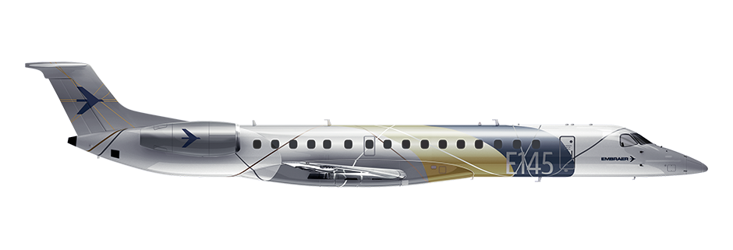

Module 3 · Costs · Long-Run & Scale
Economies of Scale in Aviation: ERJ-145 vs. 787
Embraer ERJ-145 · Regional Jet
Boeing 787-9 · Wide-Body
List price: ~ $25 M
List price: ~ $290 M
Seats: 50 passengers
Seats: ~ 290 passengers
Cost / flight-hour: ~ $1,400
Cost / flight-hour: ~ $9,000
Cost / passenger-hour: ≈ $28
Cost / passenger-hour: ≈ $31
Bigger plane → similar (or lower) cost per passenger-hour: geometry + load
Management 405 · Module 3 · Production and Costs
68
Notes:
Concrete example. Both aircraft burn fuel, pay pilots, pay landing fees – many of those costs scale with the airframe, not with passenger count. Spread across far more seats, the big plane achieves a similar or lower cost per passenger-hour. (Numbers are illustrative, based on FAA operating-cost data.) This is why long-haul routes use wide-body and short regional hops use small jets: the economics of scale depend on the load.

Slide 69
Module 3 · Costs · Long-Run & Scale
Reasons for Diseconomies of Scale
Coordination, communication, control get harder
More layers of management between strategy and the line
Information has to travel up and down a longer chain
Monitoring a bigger workforce is disproportionately costly
Misaligned incentives, free-riding, principal-agent problems
Bureaucracy and staff functions grow super-linearly
HR, accounting, legal, compliance hire to support scale
Real-world signals
Boeing's recent quality issues at scale (2024-25)
Big-tech reorgs to break ranks into smaller, accountable units
Management 405 · Module 3 · Production and Costs
69
Notes:
Why bigger isn't always cheaper. Coordination costs explode with size: longer reporting chains, more meetings, more alignment overhead. Monitoring a 50-person team is one thing; monitoring 5,000 is qualitatively different. Bureaucracy scales super-linearly – legal, HR, compliance all expand faster than headcount. Recent business-press examples drive this home: Boeing's quality issues at scale, and the wave of big-tech reorganisations explicitly framed around 'getting back to small-team velocity'.

Slide 70

Module 3 · Costs · Long-Run & Scale
Economies of Scope: Cheaper Together than Apart
Economies of scope: producing 2+ related products together is cheaper than separately
Shared input production
Shared engineering know-how & R&D
Shared brand, sales channel, marketing
Shared supply chain & customer data
Example: Airbus's A380 and A318 share engineering, supply chain, brand
British Airways A380 + A318 (CC BY-SA, Wikimedia)
Scope ≠ scale: one firm, MANY products → cheaper than splitting them up
Management 405 · Module 3 · Production and Costs
70
Notes:
Scope is the cousin of scale – but about the BREADTH of products a firm makes, not the depth of any one. Same firm, many products, sharing capabilities that are expensive to build: engineering knowledge, supply chain, brand. Airbus designed the A380 and A318 with shared engineering DNA – cockpit commonalities, pilot training, supplier base. Apple does it across iPhone/iPad/Mac (shared silicon, OS, retail). Recognising scope is what separates a firm that 'diversifies' into unrelated junk from one that genuinely lowers costs.

Slide 71
Module 3 · Costs · Long-Run & Scale
Amazon: Economies of Scale, Scope, or Both?
Amazon is the textbook case for BOTH at once — where exactly?
Economies of SCALE
Economies of SCOPE
• AWS — massive data-center fixed costs spread
• Prime = shipping + video + music + grocery
• Fulfilment network density (FBA)
• Customer data shared across retail/ads/AWS
• Bargaining power with suppliers
• Devices (Alexa, Kindle) lever the brand
Discussion Break
Management 405 · Module 3 · Production and Costs
71
Notes:
Discussion prompt. Amazon is the canonical 'both' case. Scale: AWS is a fixed-cost-heavy business where capacity is shared across millions of customers. Fulfilment is denser the more orders flow through. Suppliers offer better terms at scale. Scope: Prime bundles shipping + video + music + grocery; advertising, devices, and AWS all benefit from customer data created in retail. The strategic question for students: which of these is most defensible, and which is just incremental?

Slide 72
Module 3 · Costs · Long-Run & Scale
Mini-Case: Shark Tank Pitch — Group Discussion
Watch first: vimeo.com/236977187 (focus 4:50 – 5:40)
PollEV · Q1 Are there economies of scale in this business?
PollEV · Q2 Which deal would you choose? $100K, royalty 25¢/can vs. $75K, 15% equity
Look for: volume last year vs. this year, and average cost per can
Then estimate profit per can to compare the two deals on an apples-to-apples basis
Discussion Break
Management 405 · Module 3 · Production and Costs
72
Notes:
Group discussion. Watch the pitch (Vimeo link), focus 4:50 – 5:40 where they discuss sales volumes and costs. Two questions on PollEV. First: is this a business with economies of scale? Compare last year's volume and unit cost with this year's projection. Second: of the two deals the sharks offered, which is more founder-friendly? Comparison requires estimating profit per can.

Slide 73
Module 3 · Costs · Long-Run & Scale
Shark Tank Solution: Scale + Deal Comparison
Volume & average cost
Deals on a per-can basis
Sales last year: 135K cans
Wholesale price: $2.69 / can
Sales this year: 300K cans ↑
Profit per can: $2.69 − $1.10 ≈ $1.50
Avg. cost last yr: $1.30 / can
Deal A: 25¢ royalty / can = 16.6% of profit
Avg. cost this yr: $1.10 / can ↓
Deal B: 15% equity
⇒ AC falls as volume rises = Economies of Scale
⇒ Very similar in expected NPV terms
EoS is real here. Royalty and equity deals look similar — pick based on control & risk
Management 405 · Module 3 · Production and Costs
73
Notes:
Reveal. The numbers show a clear AC drop – $1.30 → $1.10 per can – as volume more than doubles. That's economies of scale in the can-production business. Wholesale price $2.69 leaves about $1.50 profit per can. Deal A (25¢ royalty) is roughly 16.6% of profit per can; Deal B (15% equity) is structurally similar in expected value. The real decision then turns on non-cash factors: control, signalling, dilution path, and the founder's view on probability of upside.

Slide 74
BACKUP
Management 405 · Module 3 · Production and Costs
74

Slide 75
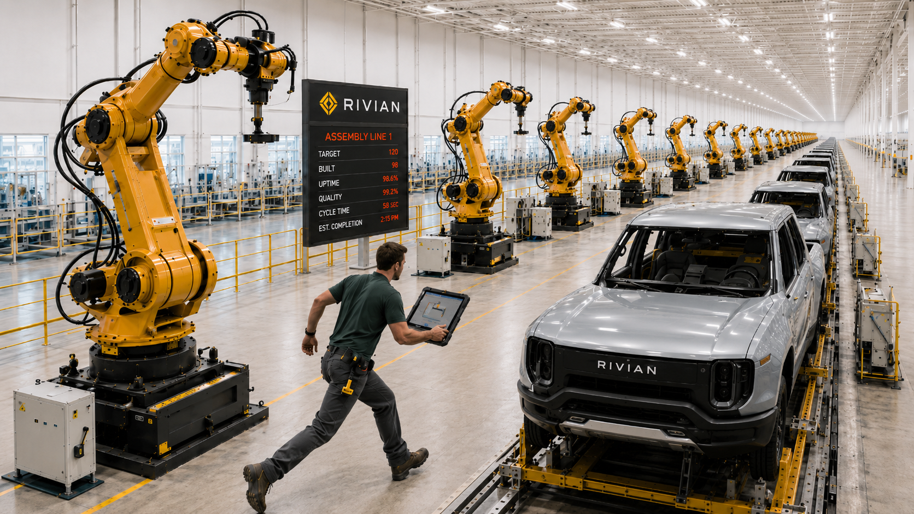
Very High MPL in the Rivian Plant
back
Notes:
Backup slide showing what a very high marginal product of labor looks like in practice — the start of Rivian's hiring ramp, where each additional worker adds a lot of output. Linked from the 'Very high MPL image' annotation on slide 16; the bottom-right back button returns to slide 16.

Slide 76
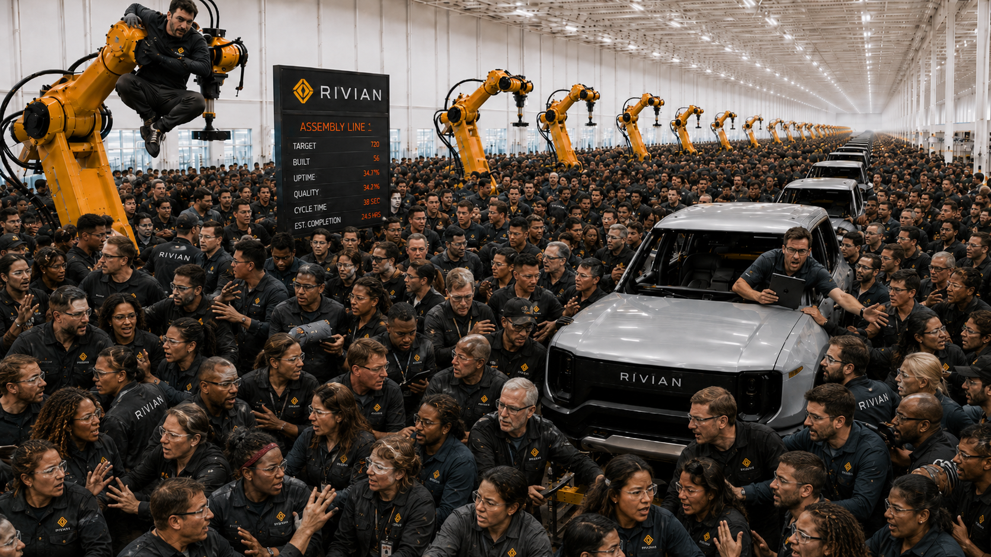
Very Low (or negative) MPL in the Rivian Plant
back
Notes:
Backup slide showing what a very low marginal product of labor looks like in practice — the saturated tail of Rivian's hiring curve, where each additional worker adds almost nothing. Linked from the 'Very low MPL image' annotation on slide 16; the bottom-right back button returns to slide 16.

